Slide 1
24-94. Presentation, update, and discussion on the Coll Street Drainage project – Phase 1
Scott McClelland, Assistant Director of Transportation and Capital Improvements
Nolan Pierce, P.E.
Kimley-Horn

Slide 2

Project Update for
Coll Street Improvements
From Castell Ave to Comal River
Castell Avenue Phase I
January 24, 2024

Slide 3
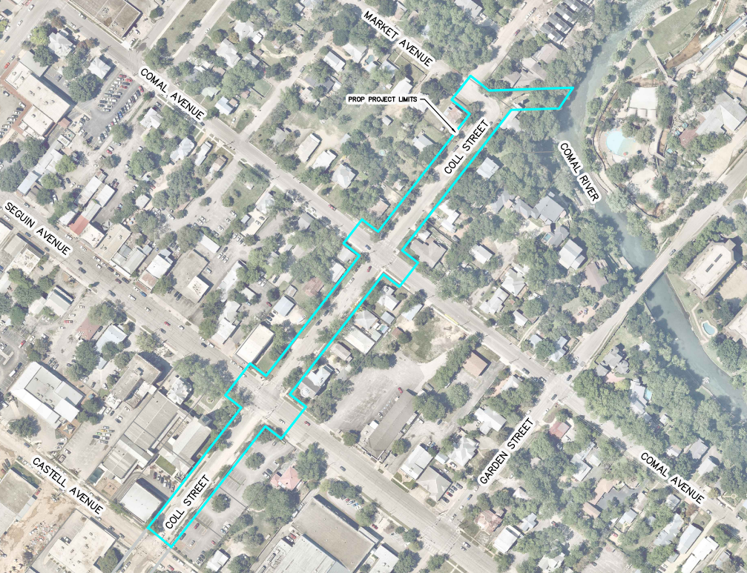
Overview
Project Background/History
Progress to Date
Proposed Improvements
Enhanced Additives
Cost
Schedule
Questions
Project Limits

Slide 4
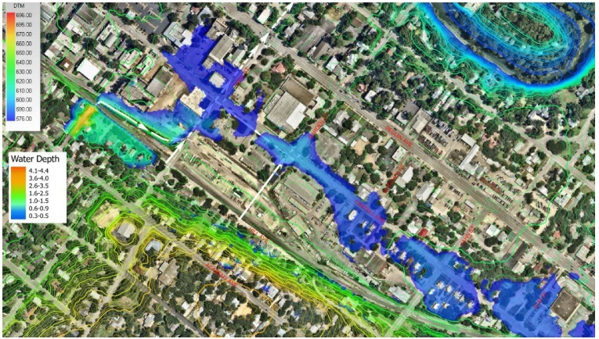
Project Background/History
Project Objective – combine efforts for future infrastructure needs identified in the PER for Castell Avenue and the Downtown ROW Enhancements preliminary study
Downstream drainage infrastructure capacity increases needed for Castell Avenue (increase size of storm system to Comal River)
Pedestrian walkability and enhancements identified along Coll Street
Existing 100-year storm flooding
Notes:
Keep or delete this slide?

Slide 5

Progress to Date
Data Collection – 100% Complete
Survey
Geotechnical & Pavement Design
Environmental Study
Construction Drawings – 60% Complete
Plans
Enhanced Improvement Alternatives Identified
Construction Cost Estimate
Public Involvement
Stakeholder Meeting with Property Owners – 1/9/2024

Slide 6
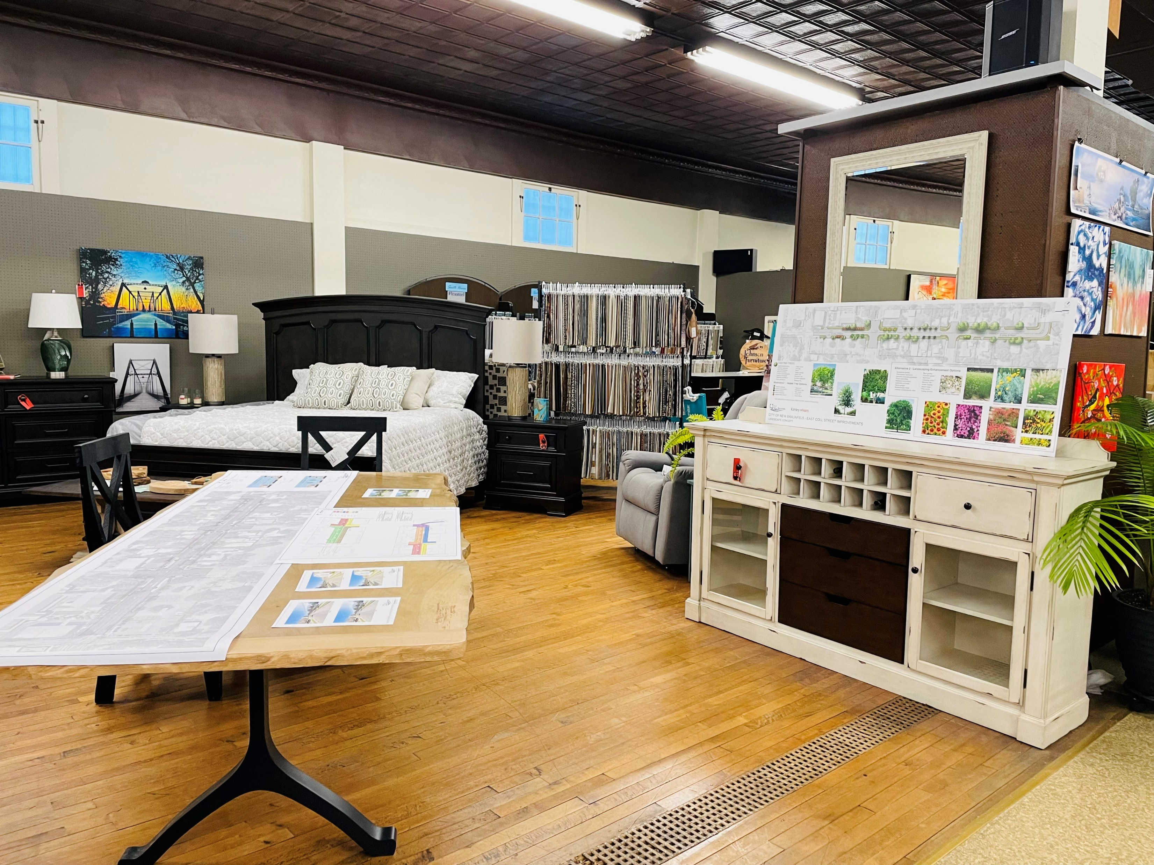
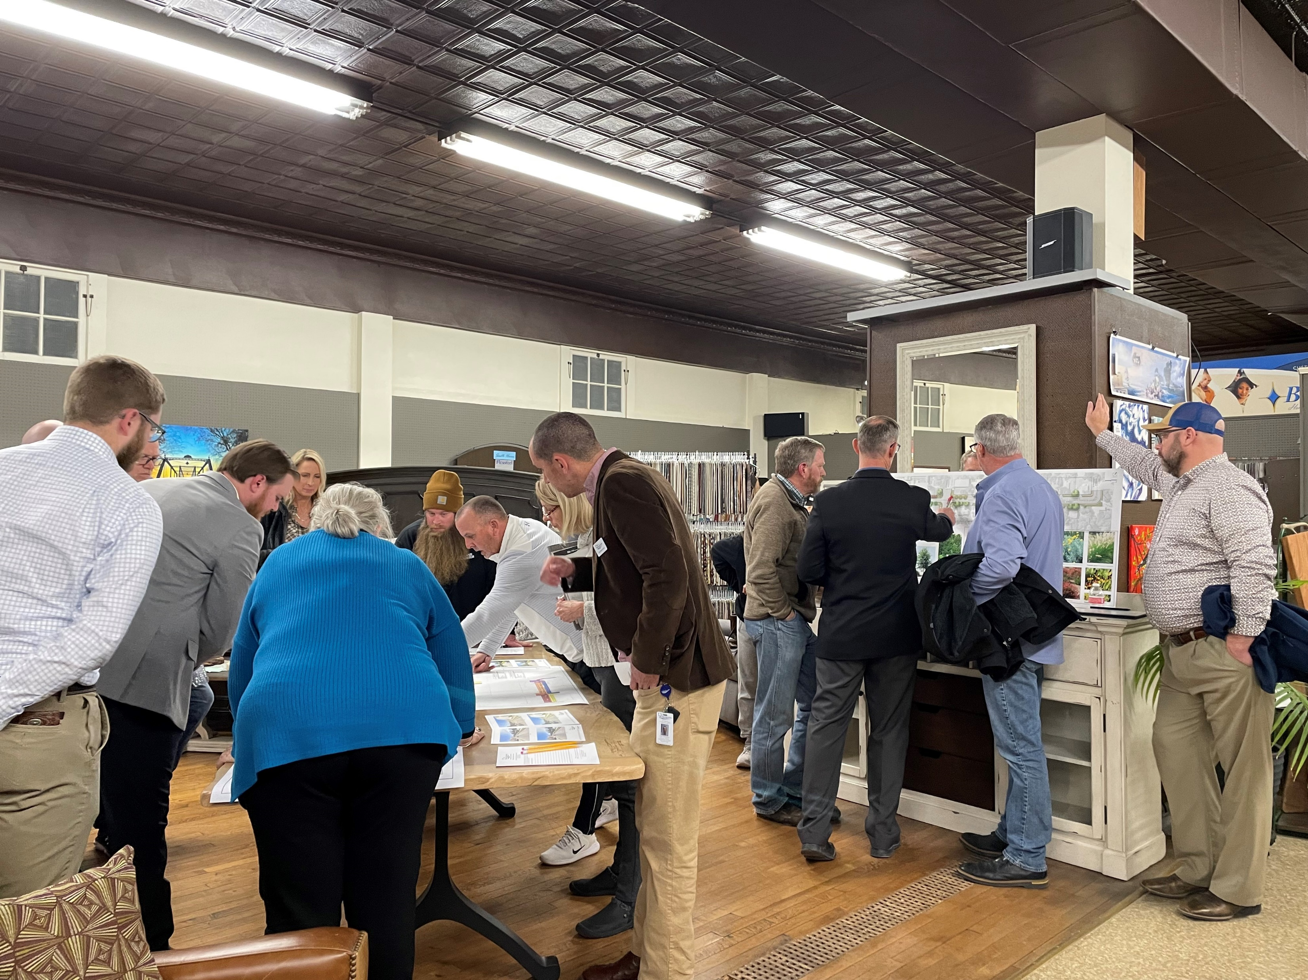
Stakeholder Meeting
Conducted on 1/9/2024 at Johnson Furniture
Received written and verbal comments
Owners looking for enhanced communication and limit impacts as much as possible during construction and to limit impacts

Slide 7
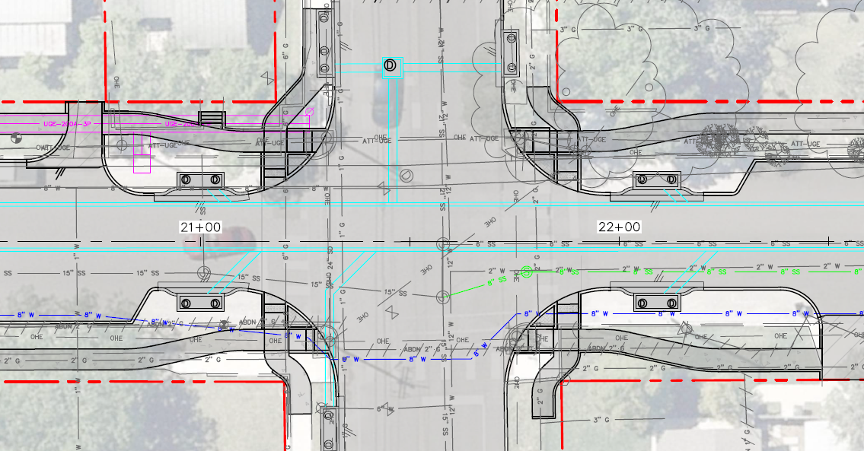
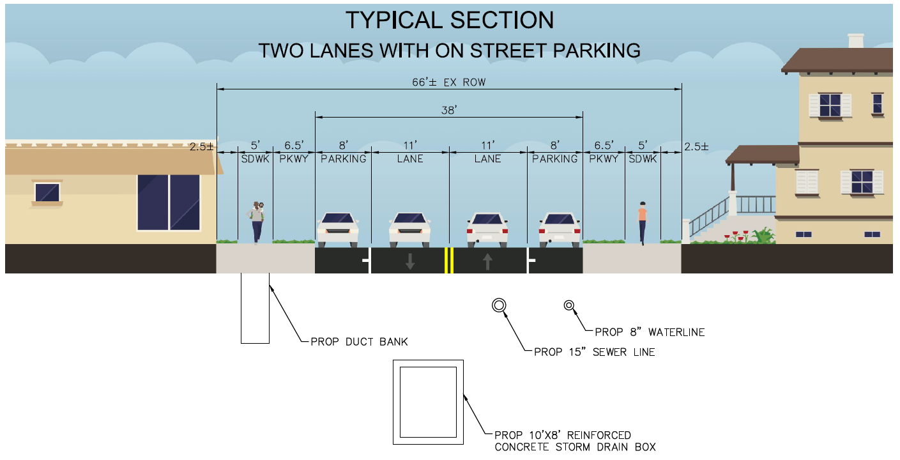
Proposed Improvements
Roadway Reconstruction
New curbs, bulb-outs, and asphalt pavement
Internal Storm Drain System
Concrete Sidewalk (both sides)
Ped signal modifications at Seguin Ave
Water & Sewer Utility Replacements (Joint Bid w/NBU)

Slide 8
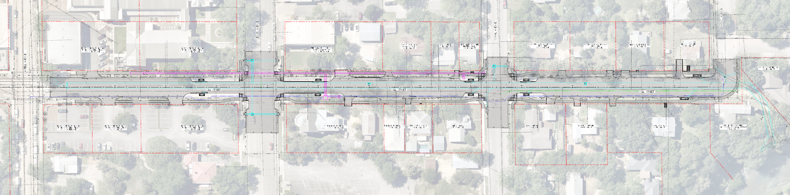

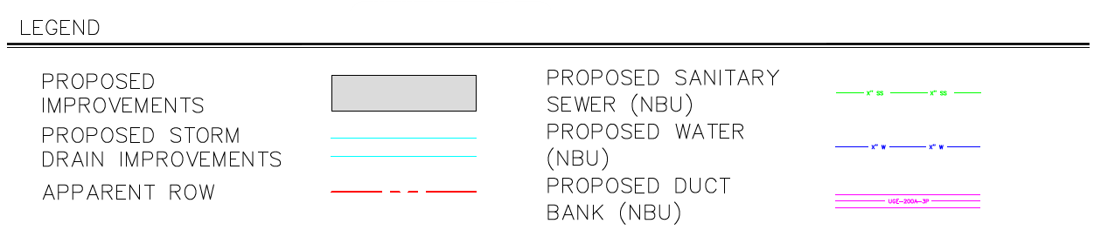
Proposed Improvements – Overall Layout

Slide 9
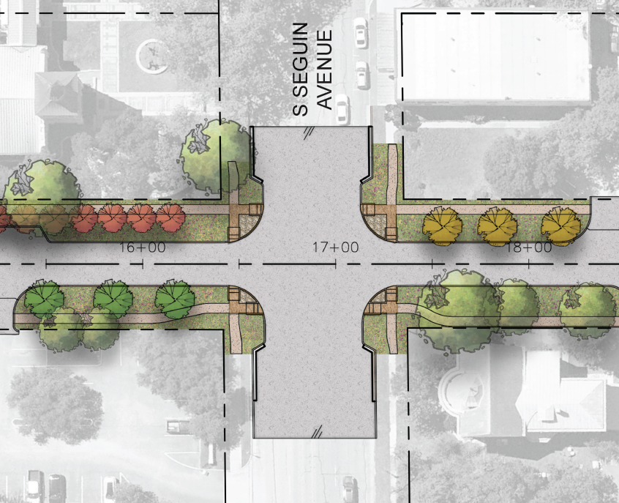
Enhanced Additives
Add Alternate 1
Proposed Trees Only
Add Alternate 2
Enhanced Landscaping including plantings and hardscape (no irrigation)
Add Alternate 3
Underground Electric & Telecommunication conversion

Slide 10
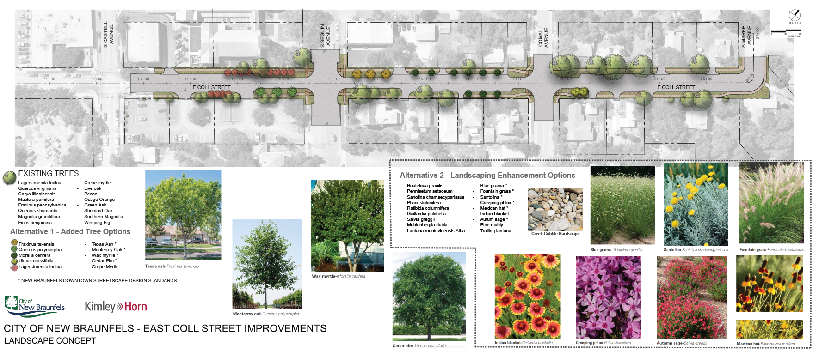
Add Alternates 1 & 2

Slide 11
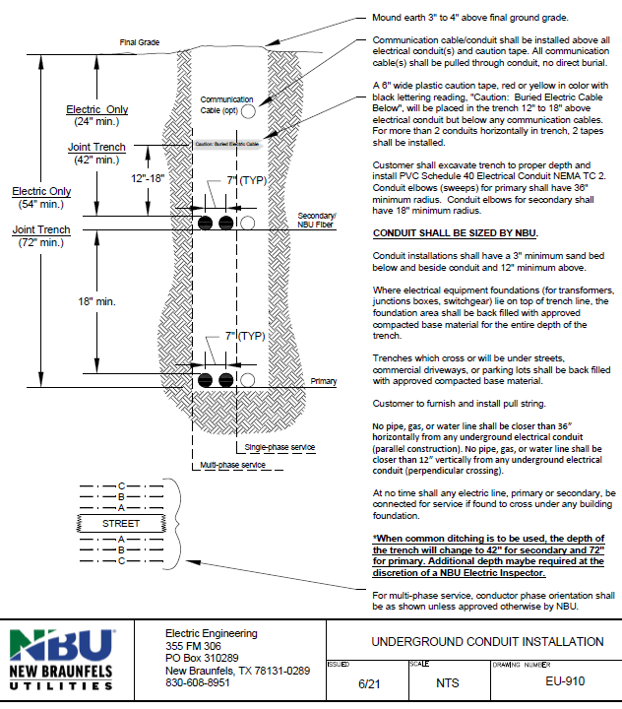
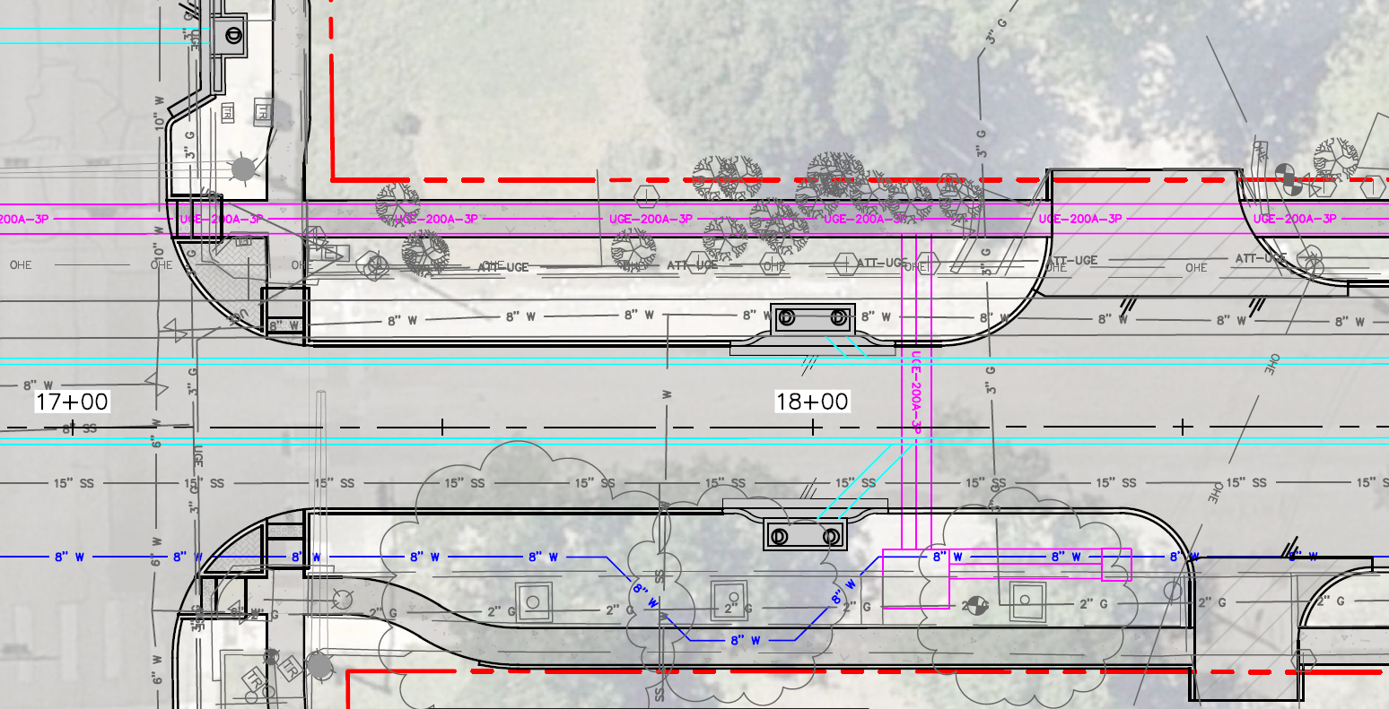
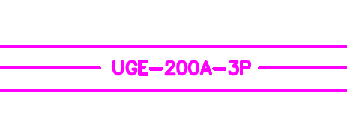
Add Alternate 3
Construction of Underground Duct Bank
Limits include from Castell Ave to Comal Ave
Requires utility coordination with multiple entities including NBU Electric, AT&T, etc.
4’ wide with multiple layers of conduit
Overground pedestals, ground boxes, and new service connections to property owners
Includes street lighting
Proposed Shared Duct Bank

Slide 12
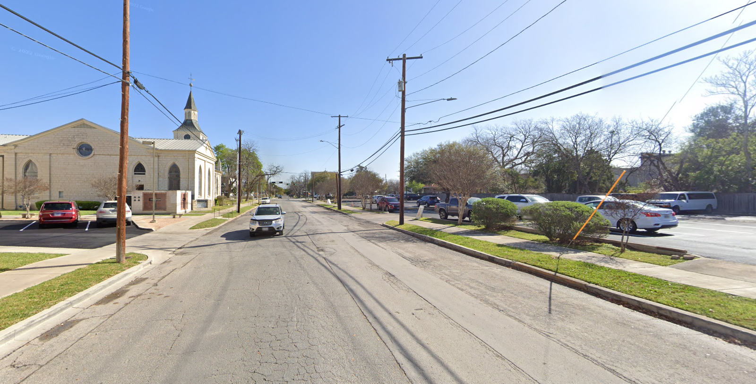
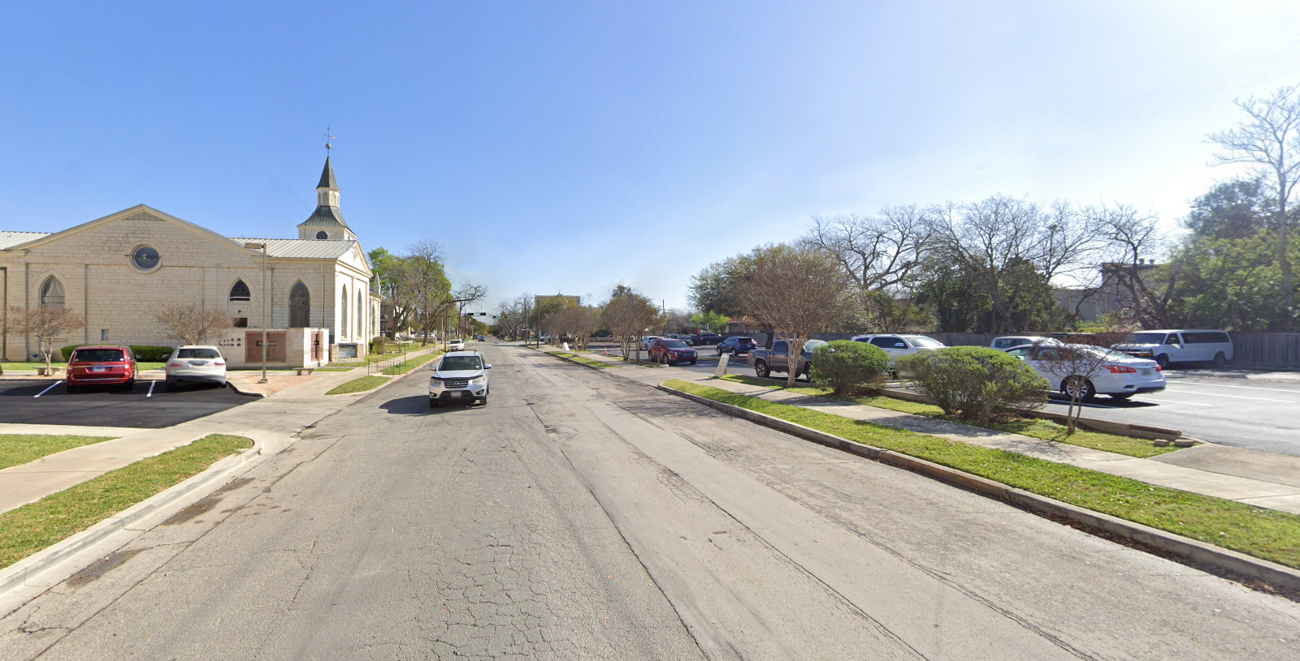
Underground Conversion Eye Level Image Examples
Before
After

Slide 13
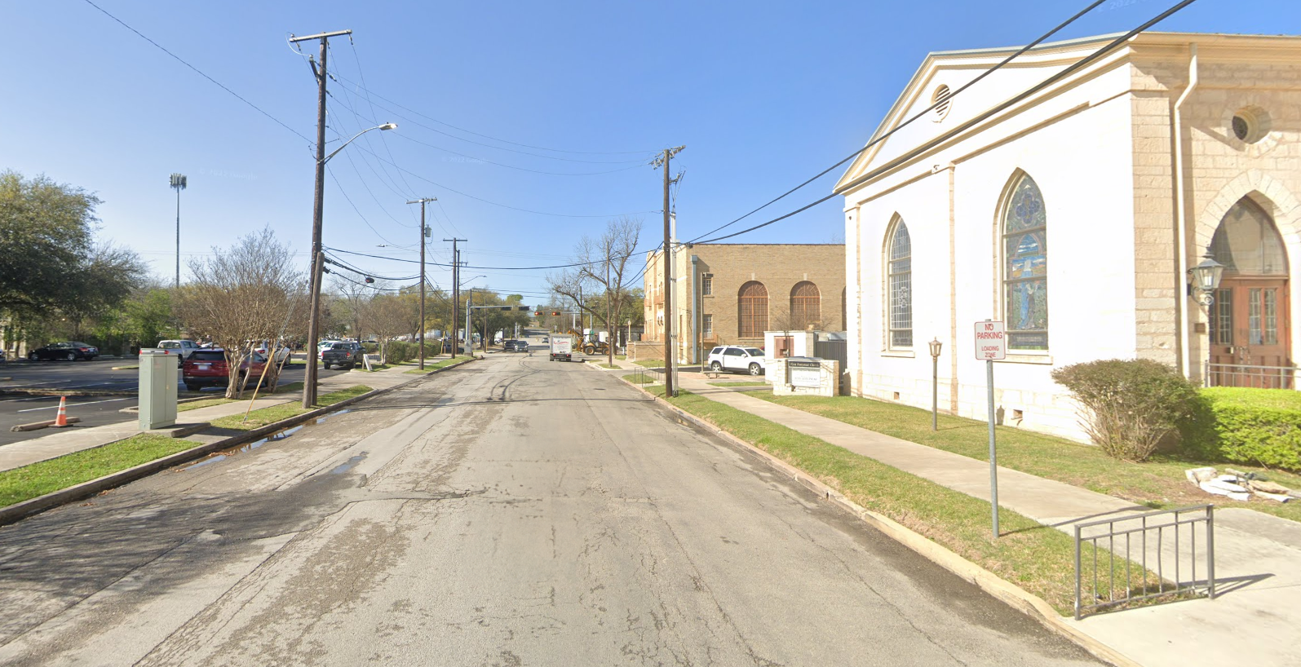
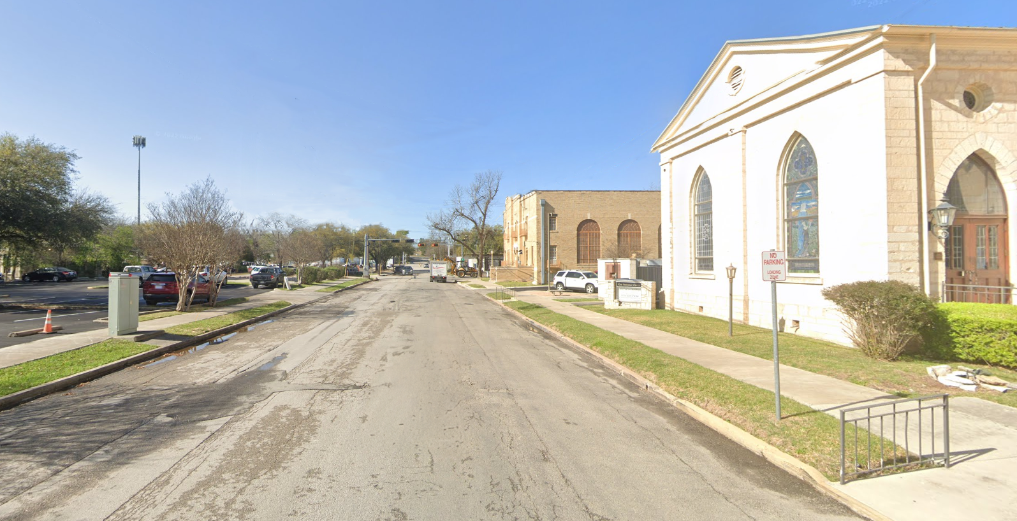
Underground Conversion Eye Level Image Examples
Before
After

Slide 14
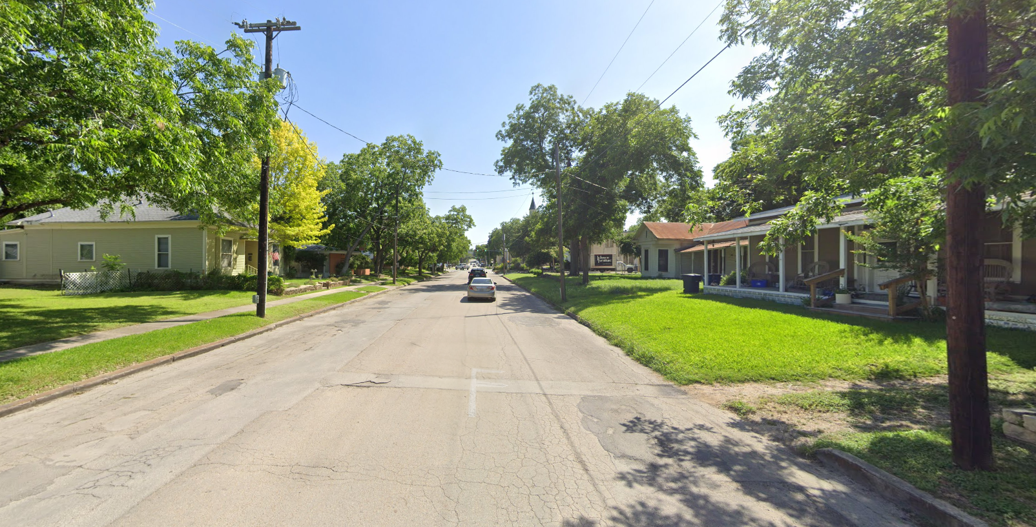
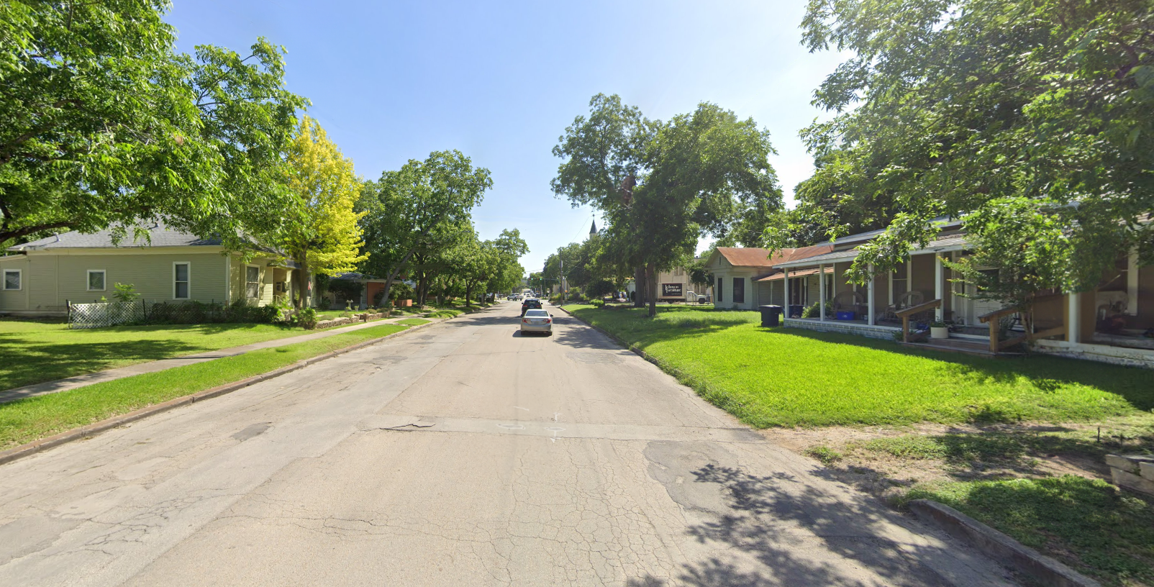
Underground Conversion Eye Level Image Examples
Before
After

Slide 15
Cost
Opinion of Probable Construction Cost
Component | Subtotal | Contingency | Total
Base Construction - Roadway, Drainage, Ped Improvements | $5,145,000 | $775,000 | $5,920,000
Add Alternate 1 – Trees Only | $41,000 | $9,000 | $50,000
Add Alternate 2 – Enhanced Landscaping & Hardscape | $156,000 | $34,000 | $190,000
Add Alternate 3 – Underground Utility Conversion | $820,000 | $165,000 | $985,000
Totals | $6,162,000 | $983,000 | $7,145,000

Slide 16
Schedule
Anticipated Project Schedule - Base
Includes: Roadway, Drainage, & W/WW
Task | Completion Date
Final Design | Summer 2024
Advertisement/Bidding | Fall 2024
Construction Start (18 Months*) | Begin 2025
Construction Complete | Summer 2026
Anticipated Project Schedule – Add Alternate 3
Includes: Base + Added Underground Conversion
Task | Completion Date
Final Design | Summer 2024
Utility Coordination/Design (18 Months) | End 2025
Advertisement/Bidding | Spring 2026
Construction Start (18 Months*) | Summer 2026
Construction Complete | End 2027

Slide 17

Questions?

